Slide 1
Greengrass
v0.1

Slide 2
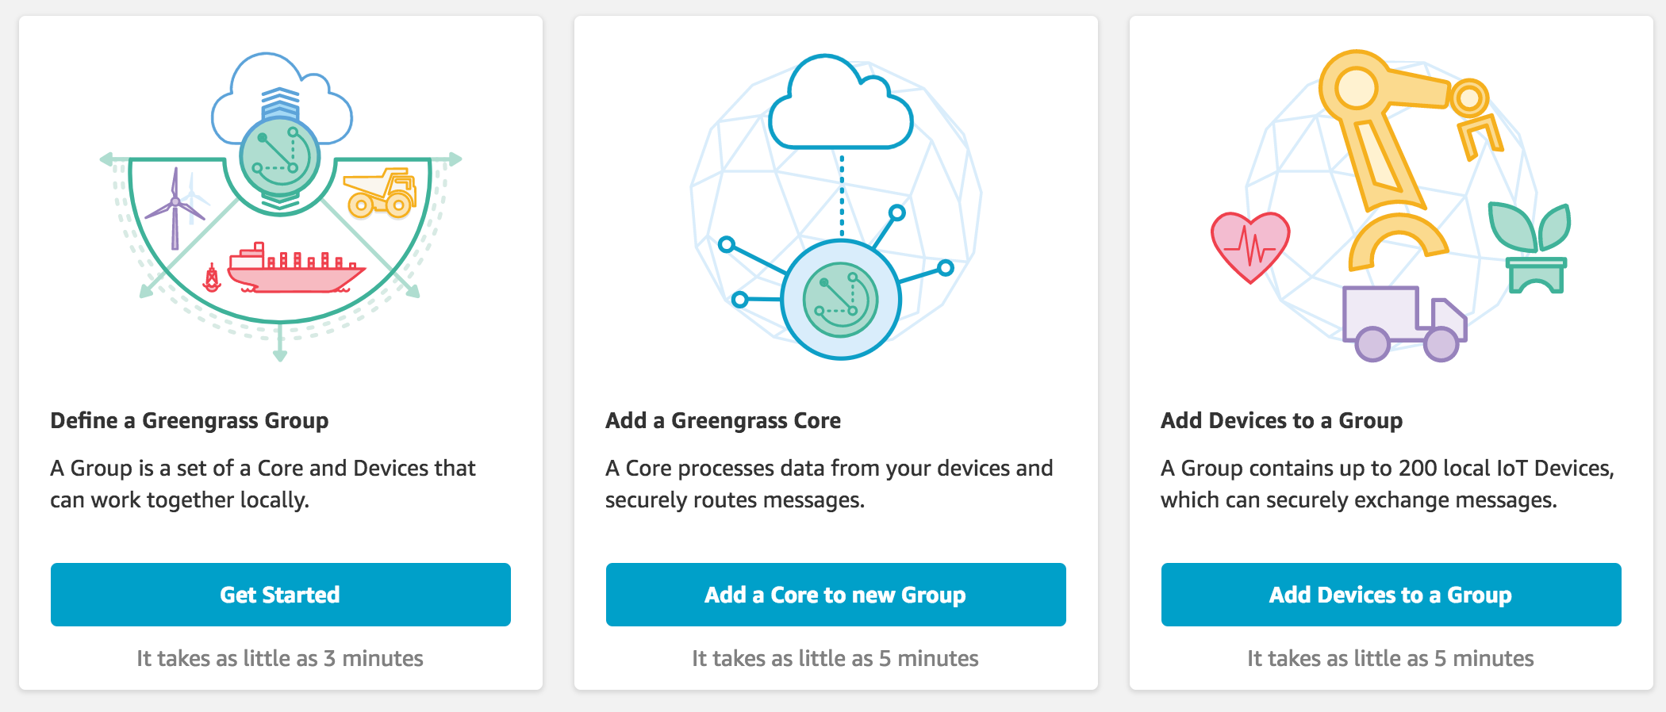
AWS Greengrass
AWS Greengrass is software that extends AWS cloud capabilities to local devices, making it possible for them to collect and analyze data closer to the source of information, while also securely communicating with each other on local networks.

Slide 3
Architecture
Developers who use AWS Greengrass can author serverless code (AWS Lambda functions) in the cloud and conveniently deploy it to devices for local execution of applications.
AWS Greengrass provides cloud-based management of applications that can be deployed for local execution. Locally deployed Lambda functions are triggered by local events, messages from the cloud, or other sources.

Slide 4
Greengrass components
Software distributions
AWS Greengrass core software
AWS Greengrass core SDK
Cloud service
AWS Greengrass API
Features
Lambda runtime
Thing shadows implementation
Message manager
Group management
Discovery service

Slide 5
Greengrass Core Software
Functionality
Allows deployment and execution of local applications created using Lambda functions and managed through the deployment API.
Enables local messaging between devices over a secure network using a managed subscription scheme through the MQTT protocol.
Ensures secure connections between devices and the cloud using device authentication and authorization.
Provides secure, over-the-air software updates of user-defined Lambda functions.
Consists of:
A message manager that routes messages between devices, Lambda functions, and AWS IoT.
A Lambda runtime that runs user-defined Lambda functions.
An implementation of the Thing Shadows service that provides a local copy of thing shadows, which represent your devices. Thing shadows can be configured to sync with the cloud.
A deployment agent that is notified of new or updated AWS Greengrass group configuration. When new or updated configuration is detected, the deployment agent downloads the configuration data and restarts the AWS Greengrass core.

Slide 6
AWS Greengrass Groups
An AWS Greengrass group definition is a collection of settings for AWS Greengrass core devices and the devices that communicate with them.

Slide 7
Security
The devices securely communicate on a local network and exchange messages with each other without having to connect to the cloud.
Greengrass provides a local pub/sub message manager that can intelligently buffer messages if connectivity is lost so that inbound and outbound messages to the cloud are preserved.
protects user data:
Through the secure authentication and authorization of devices.
Through secure connectivity in the local network.
Between local devices and the cloud.
Greengrass provides secure, over-the-air software updates of Lambda functions.

Slide 8
Devices in AWS Greengrass
AWS Greengrass cores
An AWS Greengrass core is an AWS IoT device that runs specialized AWS Greengrass software that communicates directly with the AWS IoT and AWS Greengrass cloud services.
It is an AWS IoT device with its own certificate used for authenticating with AWS IoT.
It has a device shadow and exists in the AWS IoT device registry.
AWS Greengrass cores run a local Lambda runtime, a deployment agent, and an IP address tracker that sends IP address information to the AWS Greengrass cloud service to allow AWS IoT devices to automatically discover their group and core connection information.
AWS IoT devices connected to an AWS Greengrass core.
Any AWS IoT device can connect to an AWS Greengrass core.
An AWS IoT device runs software written with the AWS IoT Device SDK.

Slide 9
Greengrass Core and IoT Device

Slide 10
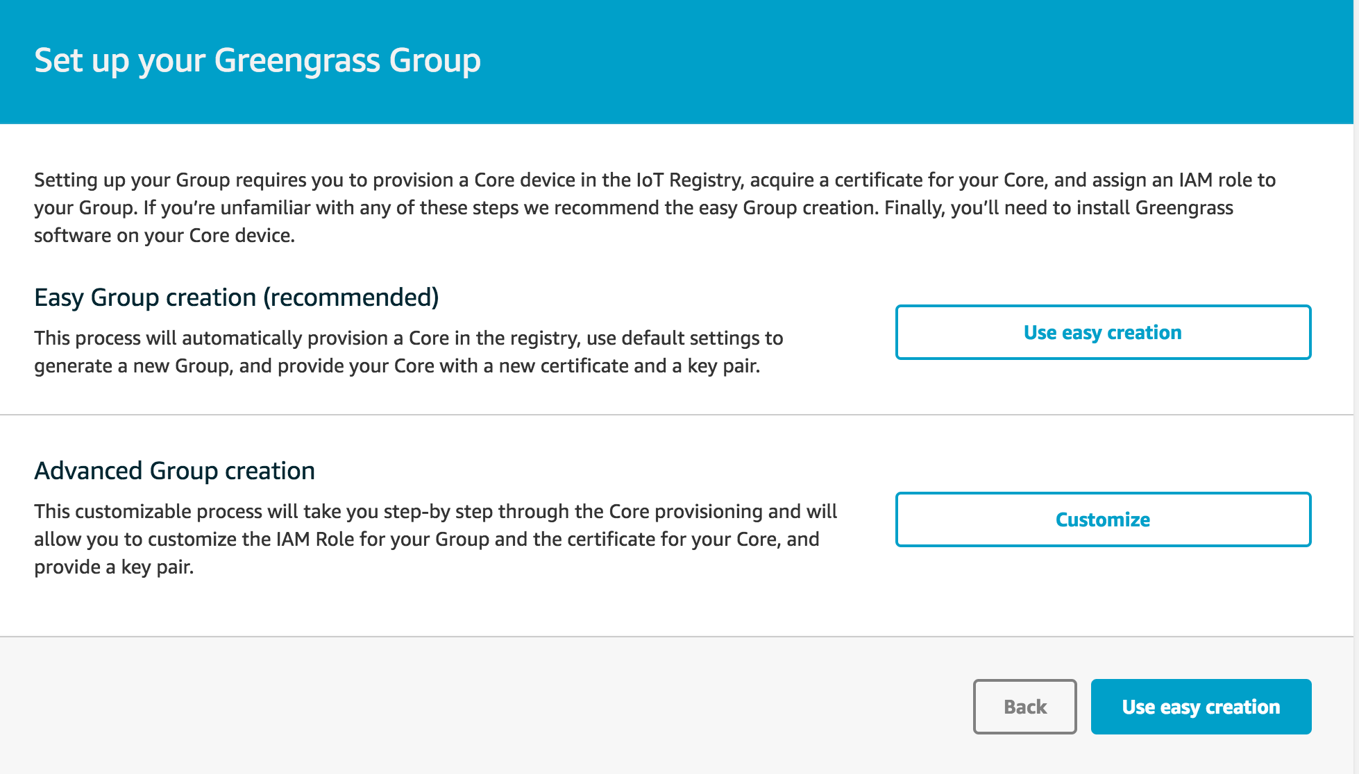
Greengrass group

Slide 11
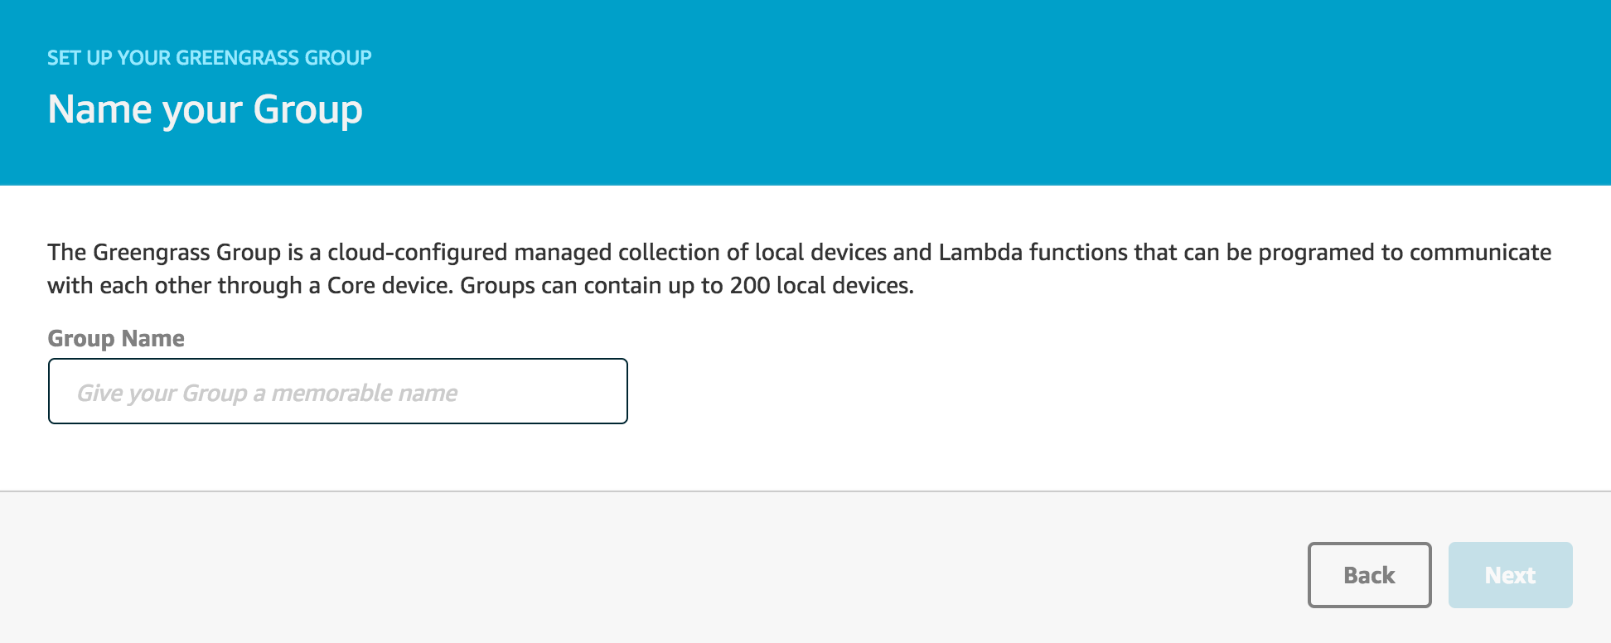
Name your group

Slide 12
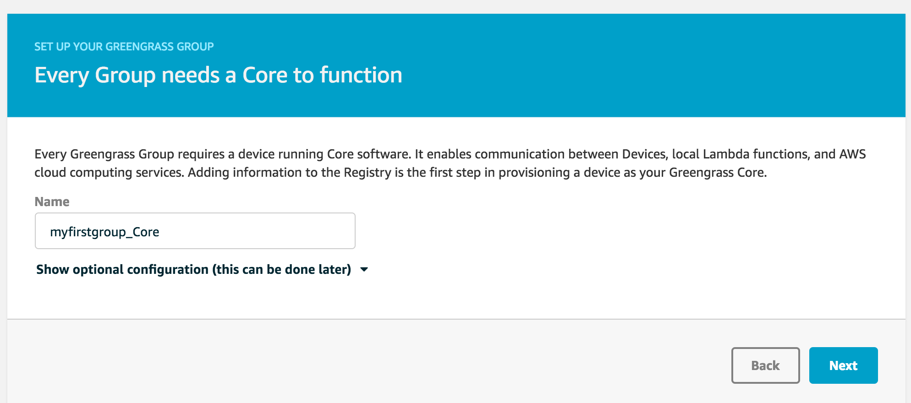
Greengrass core

Slide 13
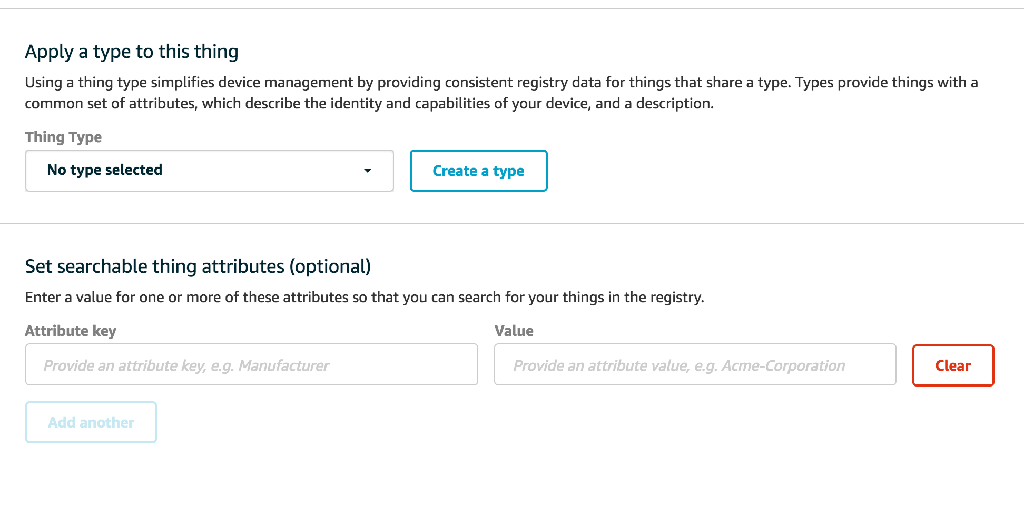
Greengrass core optional configuration

Slide 14
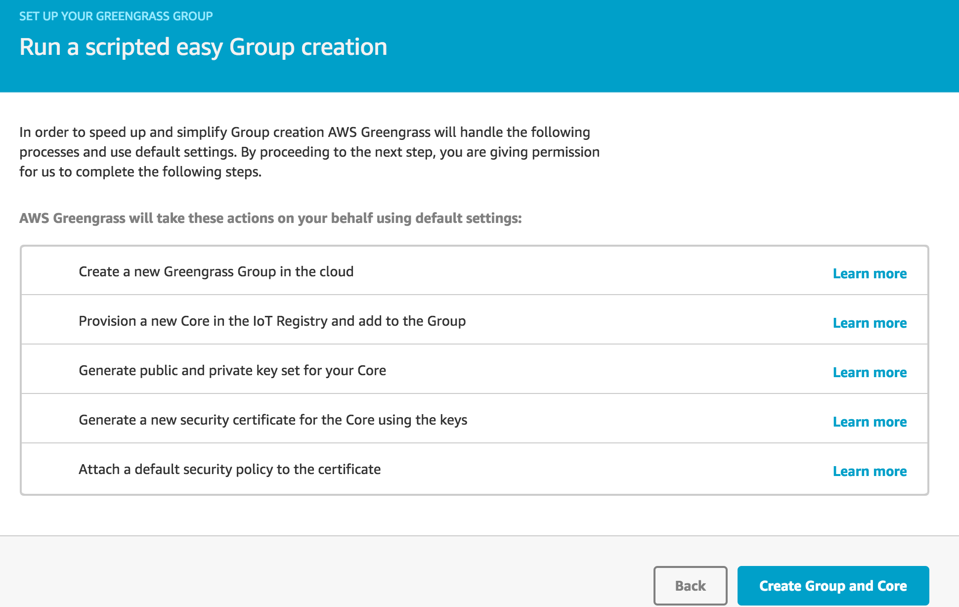

Slide 15
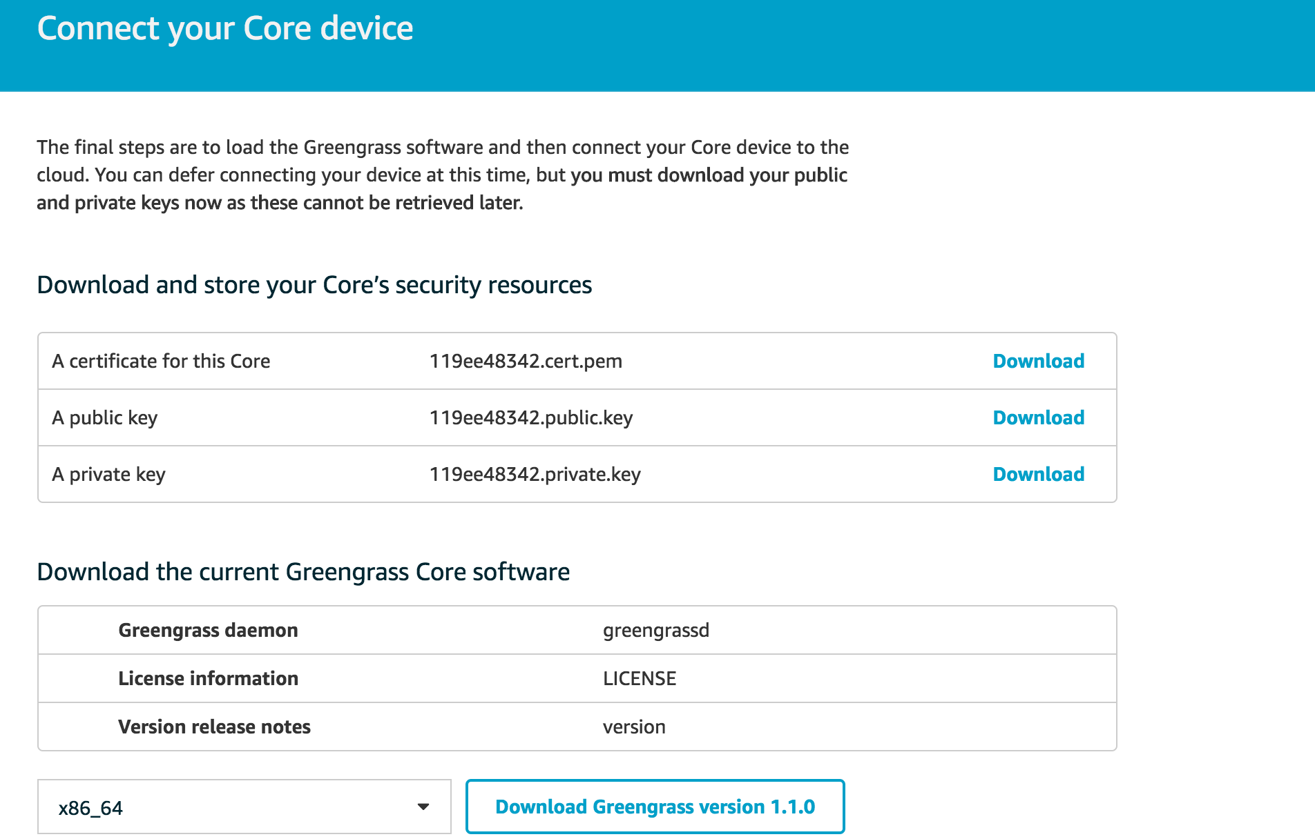
Connect core device

Slide 16
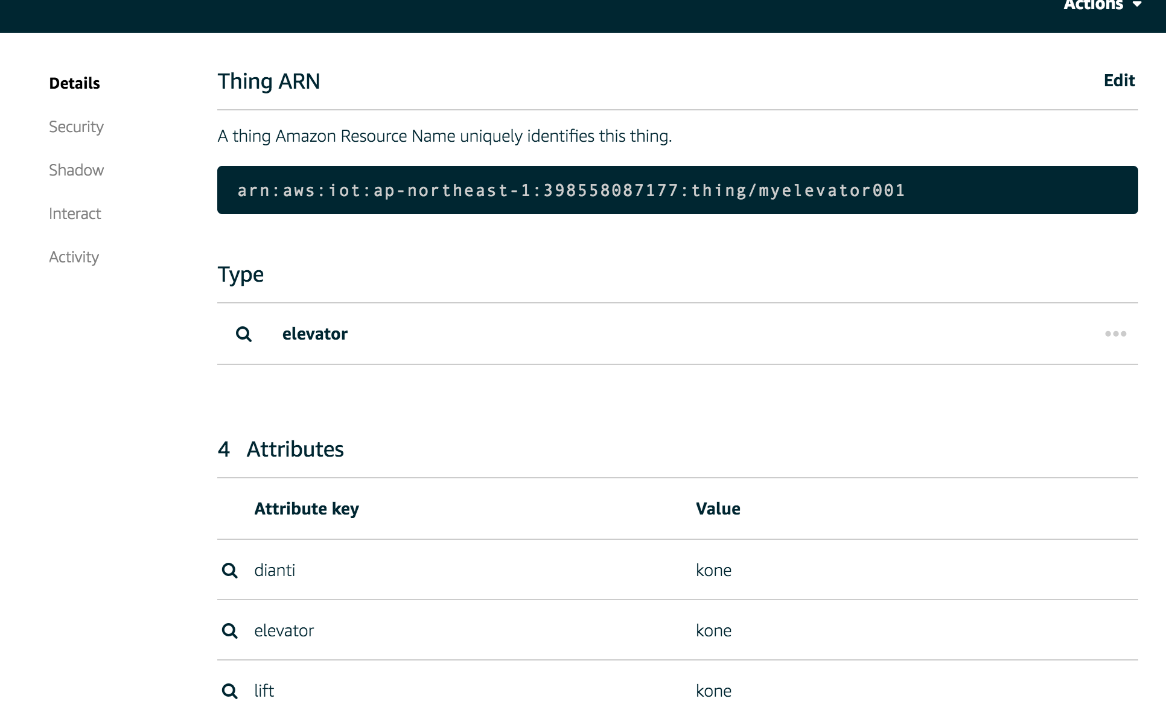
Device

Slide 18
AWS IoT Button
NEW: The battery-life is now extended to over 2,000 clicks and companionable mobile applications allow you to get started quickly.
This programmable Wi-Fi button is designed to help developers learn how to use AWS IoT, AWS Lambda, DynamoDB, Simple Notification Service and other Amazon Web Services.
An easy way to get started with the Internet of Things, based on the Amazon Dash button hardware, the AWS IoT button is a developer kit that can be programmed to control internet-connected devices and services.
Eliminate the hassle of writing device-specific code; code in the cloud to configure your button’s single, double, and long clicks.
Connect the AWS IoT Button to services in the AWS Cloud with a single click.

Slide 19
AWS IoT Button
AWS IoT 按钮是一种易于配置的简单 Wi-Fi 设备，专为帮助开发人员开始使用 AWS IoT、AWS Lambda、Amazon DynamoDB、Amazon SNS 及众多的其他 Amazon Web Services 而设计，无需编写特定于设备的代码。
您可以在云中对按钮进行逻辑编码，配置按钮单击以计数或跟踪项目、呼叫或提醒某人、启动或停止某些操作、订购服务或甚至提供反馈。例如，您可以通过单击按钮开锁或启动汽车、打开车库门、叫计程车、呼叫配偶或客户服务代表、跟踪常见家务的进行情况及药物或商品的使用情况，或远程控制家用电器。
该按钮可用作 Netflix 的远程控制器、Philips Hue 灯泡开关、Airbnb 房客入住/退房设备，或者用来订购您最喜欢的披萨外卖。您可以将它与第三方 API (如 Twitter、Facebook、Twilio、Slack)，或者甚至您自己公司的应用程序进行整合。将它与我们甚至不曾想到的对象建立连接。我们非常期待看到您对 AWS IoT Button 的运用！

Slide 20
将单击操作路由至 AWS 服务
配置 AWS IoT Button，将其接入 Wi-Fi 网络，并使用 AWS IoT 证书和私有密钥预置按钮后，按钮将安全地连接到 AWS IoT 并在单击后发布一条主题消息。您可以使用 AWS IoT 规则引擎设置规则，并配置路由到任何 AWS 服务的单击、双击或长按事件。还可以对其进行配置，使它通过 Amazon SNS 向您发送通知，或将所有点击事件保存到一个 Amazon DynamoDB 表中。您甚至可以使用 AWS Lambda 函数对 Node.js、Python 或 Java 中写入的自定义逻辑进行编码，然后配置函数以连接到第三方服务或其他采用 AWS IoT 技术的连接终端节点。

Slide 21
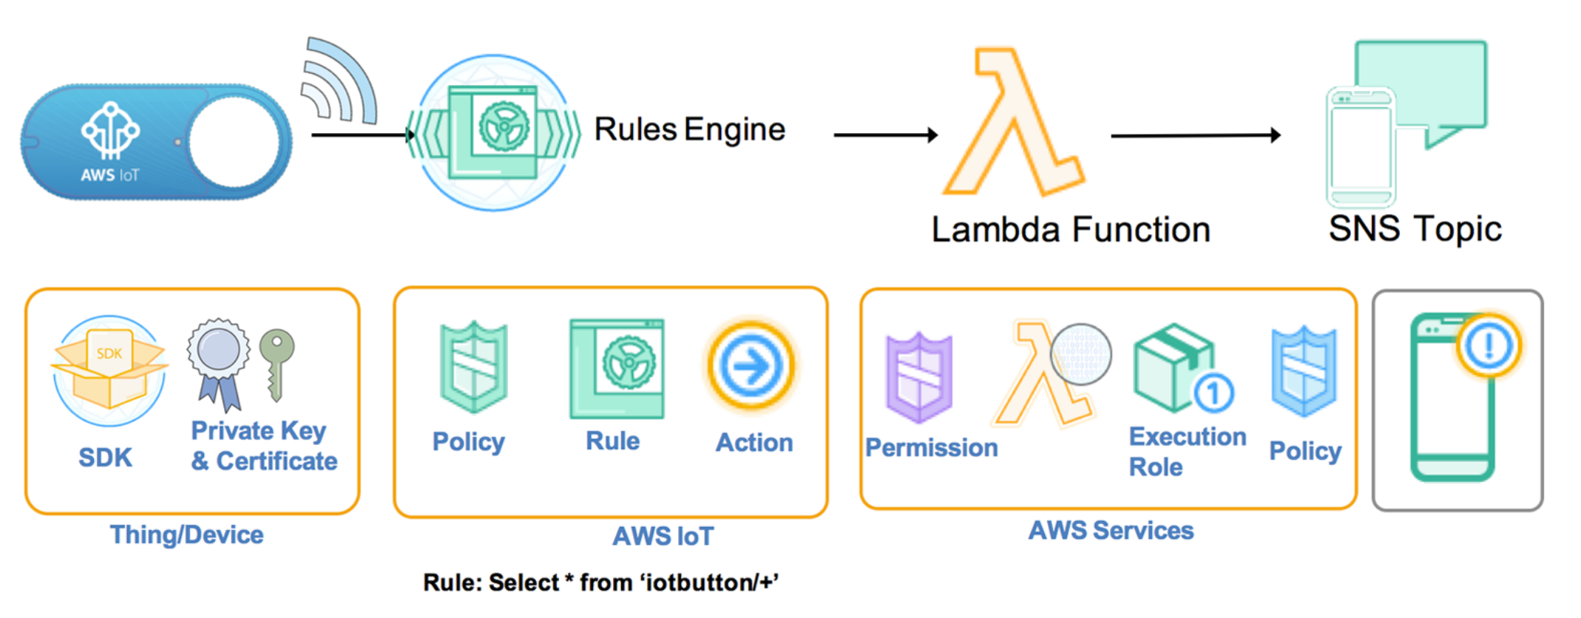

Slide 22
Backup

Slide 24
IoT Ecosystem
AI Chatbot System
3
IoT Cloud Core
Implementation
Control device through conversational API
Python
Java
Spring Cloud
Nosql
Spark
Hadoop
IoT Insight Service based on leading edge technologies
2
5
Data Ingestion &
Real-time Analysis
Knowledge & Graph Analytics
ML | DL
Graph Data & Knowledge Base
NLU
SKlearn
Keras
TensorFlow
Caffe
Yolo
Faster-RCNN
Algorithms
1
Machine | Deep Learning
Connection Protocol
IoT Edge
& Devices
Cloud Native
Predictive Maintenance
& Anomaly Detection
Docker
Kubernete
4

Slide 25

IoT enabled Applications
Realtime and historical API & UI
3
Message Hub (Kafka)
Authentication & Authorization
IoT Hub
IoT Analytics
External Datastore
2
4
8
Application
Rule
Engine
(anomaly detection,filter,processor,etc)
Advanced Analytics
(enrich,convers,merge,aggregate,etc)
Action Plugins
Event
MQTT
CoAP
Plugin
External Message Hub
API
API
1
HTTP
WebSocket
API
Device
Gateway & Edge Analytics Agent
Event
Event
3rd Party
Cloud Services
Device
Device
Event
Device
Device Registry
Metadata & Event Management
Device Shadow
5
6
7
Mongo
Cassandra
Mongo
Cassandra
API
Event &
State Cache
API
API
SDK
IoT Platform

Slide 26
Conversation System
Speech Recognition
Natural Language Understanding
Dialog Engine
NLU Engine
Dialog Engine
Voice
Intent
Entity
Reference
Engine
Response Action
STT
TTS
今天天气如何？
State Management
Inbound/Outbound API
Training
Training
Text
Model Management
今天天气不错....
Model
Training Data
Pipeline Config
External System

